Slide 1
BAHÁ’Í CENTER ASSISTANCE CORPORATION
AKA ‘BCA’

Slide 2
INTRODUCTION
Welcome to Bahá’í Center Assistance (BCA) board’s presentation
My name is Farshad F. Monfared and along side my esteemed colleagues
Ms. Kerry Mogharebi
Mr. Ron Lillejord

Slide 3
BAHÁ’Í CENTER ASSISTANCE CORP
An Agency of The National Spiritual Assembly of Bahá’ís of the United States (NSA)

Slide 4
BAHÁ’Í CENTER ASSISTANCE CORP. (BCA)
BCA an agency of the National Spiritual Assembly of the Bahá’ís of the United States
Became operational in December 2005, after considerable investigation, consultation and planning since 1999.
The National Spiritual Assembly provides ongoing direction and guidance to BCA through its Office of the Treasurer.

Slide 5
THE PRINCIPAL ROLE OF BAHÁ’Í CENTER ASSISTANCE CORP. (BCA)
Bring attention to the guidance about Bahá’í facilities
Provide
Training
Technical Assistance
Ongoing Consultation with Communities / LSAs

Slide 6
BAHÁ’Í CENTER ASSISTANCE CORP. (BCA)
Since inception the BCA has visited communities:
South West to North East,
South East to North West,
That includes states from Kentucky & Alabama to Wisconsin
From New York to California, Washington to Florida and….

Slide 7
BAHÁ’Í CENTER ASSISTANCE CORP. (BCA)
The BCA board has the honor / privilege of in person meetings with
35+ Local Spiritual Assemblies (LSAs)
55+ Communities
Plus numerous Conference Call and email communications

Slide 8
BAHÁ’Í CENTER ASSISTANCE CORP. (BCA)
The joy of years of consultation and bounty of visiting numerous communities and LSAs has help us to create a
1- Comprehensive (about 164 pages) Technical Manual
2- Comprehensive Database of the Facilities including pictures

Slide 9
BAHÁ’Í CENTER ASSISTANCE CORP. (BCA)
As a resource to beloved Assemblies we provide:
1- Availability to Consult upon LSA’s Request
Info@bahaicenterassistance.org
(847) 425-7940
2- Technical Manual
3- Website: http://www.bahaicenterassistance.org/

Slide 10
THE PURPOSE OF BAHÁ’Í FACILITIES
FROM 1996 TO 2021 THE BAHÁ’Í WORLD IS FOCUSED ON ONE AIM:
“ADVANCING THE PROCESS OF ENTRY BY TROOPS AND ON ITS SYSTEMATIC ACCELERATION”
MESSAGE DATE 26 NOVEMBER 1999 UNIVERSAL HOUSE OF JUSTICE TO THE BAHA’IS OF THE WORLD

Slide 11
SYSTEMATIC AND SUSTAINABLE GROWTH
“Experience has shown that it is the friends’ focus on the core activities that determines the extent to which a Center furthers the aim of entry by troops and promotes growth in a community …….Before taking action to acquire, expand, or renovate a Baha'i Center, Assemblies need to give careful consideration to the question of whether such action would support or detract from their communities’ core activities and pursuit of other elements of the Plan…”
Letter dated November 28, 2007 to Local Spiritual Assemblies from the National Spiritual Assembly of the Bahá’ís of the United States
One important principle that the BCA emphasizes in accompanying local communities is that their facilities serve the community and the Plan, and not the other way around.

Slide 12
PRIMARY FOCUS ON THE PLAN
The prime directive of any activity or resource, including a facility or center, is to serve the current Plan. Therefore Baha'i communities and the Spiritual Assemblies that serve them are responsible for aligning their resources in support of the core activities of the Plan.
A facilities size should be proportionate to the community’s size resources and needs. Small and mid-size centers are the best fit for most communities.
Large facilities, while impressive, are sometimes not what is called for, as they can divert much needed money, energy, attention and time from the urgent needs of the teaching and consolidation work.

Slide 13
HOW BAHÁ’Í FACILITIES SERVE INDIVIDUALS, THE COMMUNITY AND THE INSTITUTIONS
In support of individuals, facilities/centers can offer services and resources that provide information – i.e. a bookstore or a lending library
Facilities can also provide activities that help develop the devotional character of their communities with prayer gardens, meditation rooms and “Tranquility Zones”. These can be a service for the Baha'i's as well as the community at large.
Centers are used in an institutional capacity for Nineteen Day Feasts, Holy Days, Assembly meetings and outward-oriented core activities – i.e. devotional gatherings, children’s classes, junior youth empowerment activities and study circles.
Reflecting the importance of the arts in our communities, Baha'i facilities can offer a wide variety of artistic activities including open-mic events, jazz jams, poetry readings, choir or band practice, music lessons, art classes, children's drama, and many more

Slide 14
OUTWARD ORIENTED SERVICE THE POSSIBILITIES OF SERVING THE WIDER COMMUNITY ARE ENDLESS.
“The most precious and telling attribute any organized group of Baha’is possesses is the vitality of its community life, for the world will increasingly measure our success as a religious community by the vibrancy and joy it reflects.” (Letter of National Spiritual Assembly, November 28, 2007)
A few of the services the BCA has seen over the years:
Neighborhood gardens, various classes in service to the individual and community
Cafe Ruhi, Soul Food, open mic,
Memorial Services, weddings, family reunions, baby showers, wedding showers, children’s play groups,
Teaching walls and free literature for the public
Charity fundraisers, Disaster relief shelter,
Use by other community groups and organizations for meetings, classes and events
For a more complete list please see the list of 101 Uses of Bahá’í Centers on the Bahá’í Center Assistance website (bahaicenterassistance.org)

Slide 15
TEACHING WALLS

Slide 16
Notes:
Here we see the foyer and entrance walls at the Baha'i Center in Bellevue Washington. Similar to the quality of displays in the Willmette Welcome Center as well as the World Center Visitor Center in Haifa.. These displays speak for themselves and are a huge investment in the presentation to the public. As is the situation today when a facility is utilized by various community groups and friends of the Faith, this can potentially be a very worthwhile effort in teaching the Faith.

Slide 17
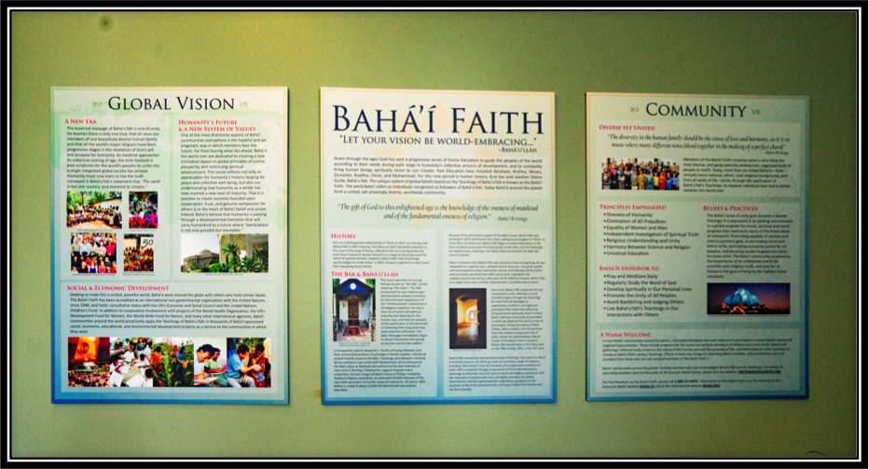
Notes:
These displays in Bellevue were very informative, and a great introduction for a first time visitor to the facility. The BCA has heard comments in several facilities over the years, that visitors and seekers often seem moved when they examine and discuss the history and the quotations alongside community members.

Slide 18
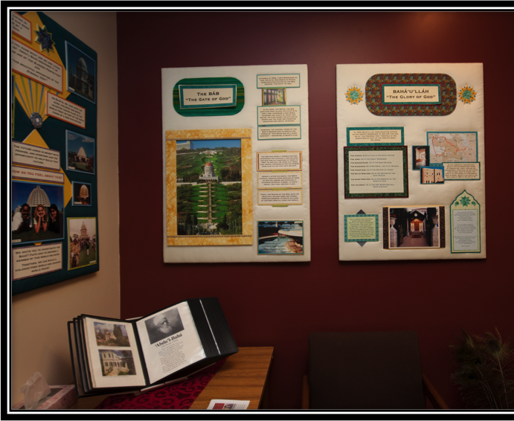
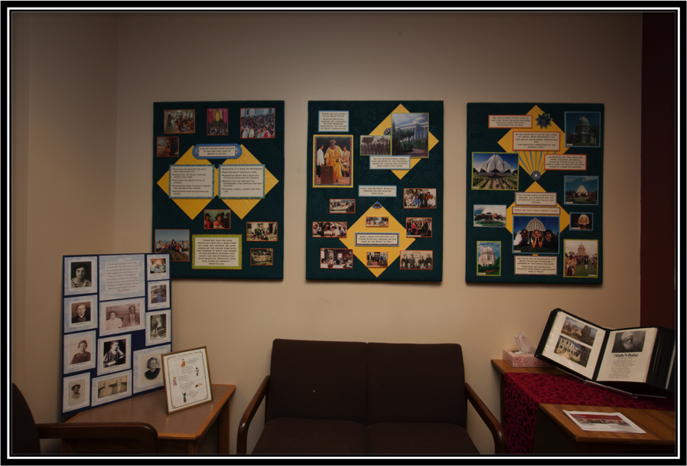
Notes:
Champagne-Urbana, Illinois was a warm and inviting facility. It is located right in the middle of a neighborhood that was perfect for outreach and core activities. While their ”teaching walls were not professionally done, they are attractive and informative. They also created displays which spoke to the history of the Faith in their community, and some of their well known believers…..

Slide 19
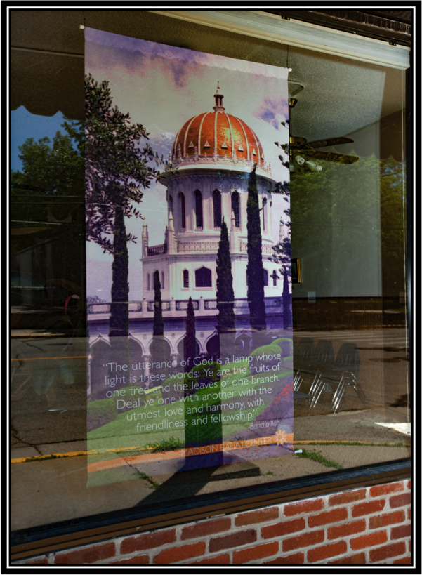
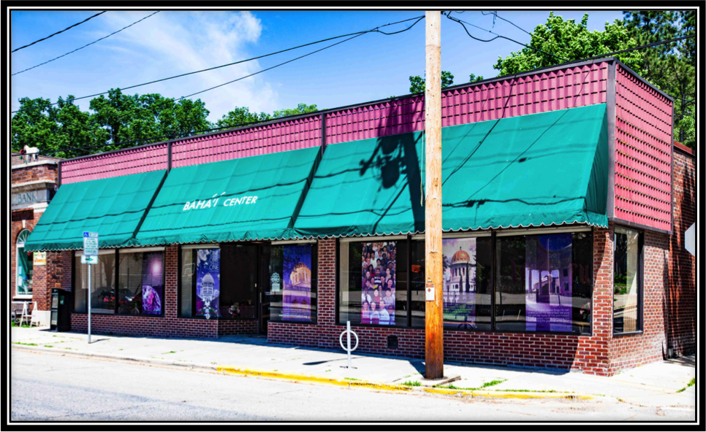
Notes:
Madison Wisconsindecided to make good use of their very large store front windows, displaying professionally created banners with images and writings of the Faith. This facility has a lot of street and walking traffic in the neighborhood.

Slide 20
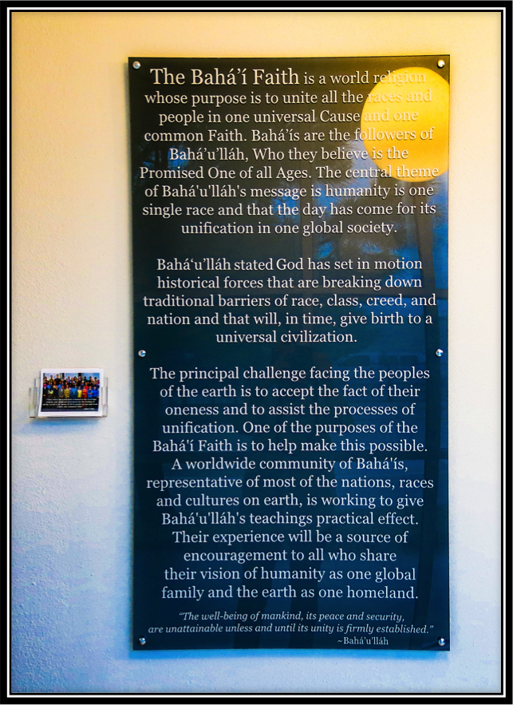
HOUSTON, TEXAS
Notes:
My visit to the Houston Baha'i facility was five years ago in 2013. I was amazed as this was the first facility I had seen that was not only professionally done, but also museum quality. Since then we have seen more facilities with beautiful and inspiring displays.

Slide 21
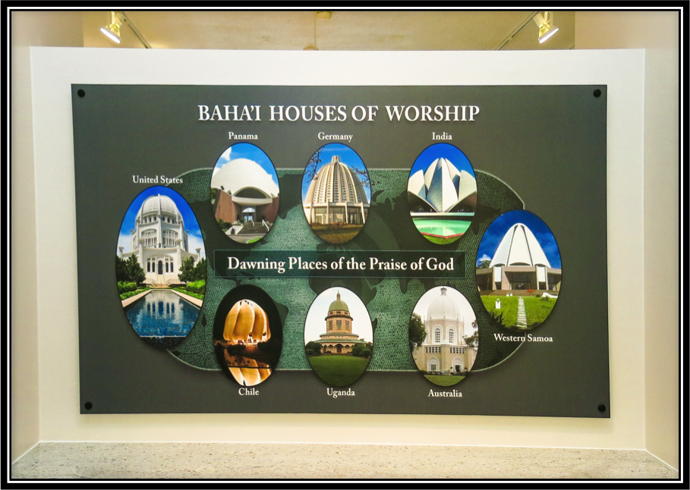
HOUSTON, TEXAS
Notes:
Inside and out, the Houston Facility was a wealth of examples of brilliant silent teachers.

Slide 22
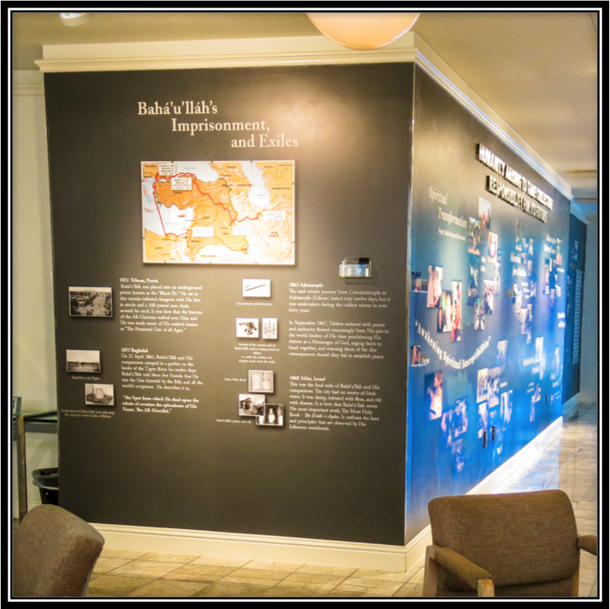
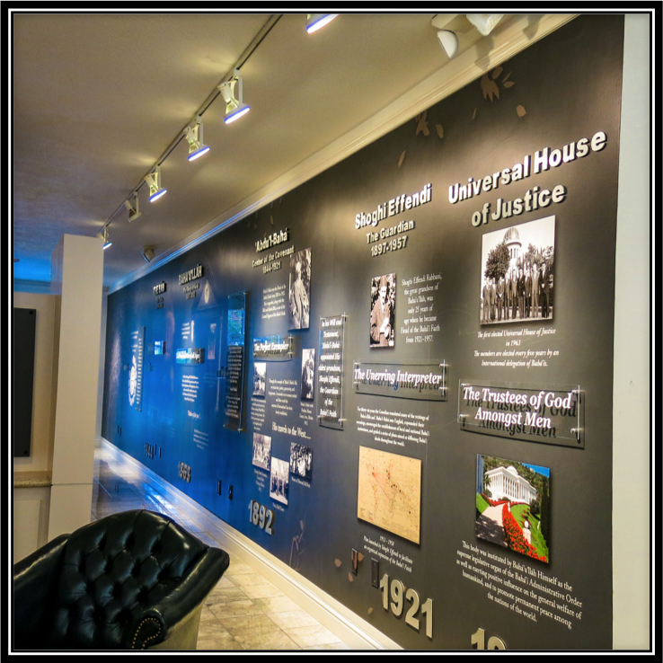
Notes:
Houston's teaching walls are so well created that they speak for themselves.

Slide 23
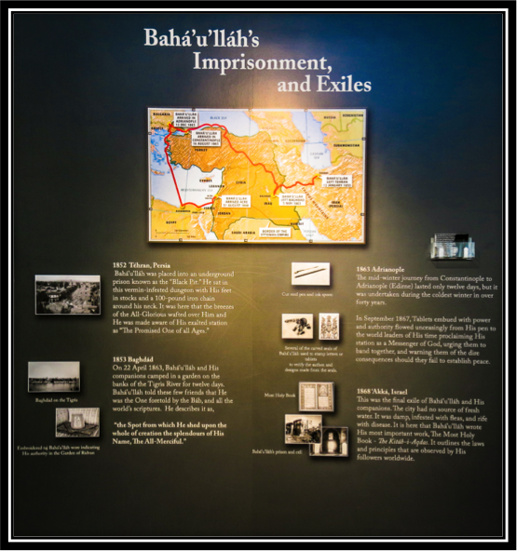

Slide 24
ROCKFORD, ILLINOIS
Notes:
Rockfield, Illinois also had an abundance of attractive and informative visual arts displays in their facility. These were situated in an area that was set up for group meetings and had the atmosphere of a warm living room environment.

Slide 26
•How does a Bahá’í facility express the teachings of Bahá'u'lláh to a casual visitor or interested inquirer? How does it convey what Bahá’ís do as a community and the aims of those activities? How does it support believers in teaching the Cause?
•There are as many possibilities as there are facilities. Some facilities, such as Eugene, Oregon have utilized outdoor space to create artistic expressions of Bahá’í writings in their gardens for passers-by to see. Some have utilized walls with messages and art combined. Some have used banners in windows with beautiful photographs and the Bahá’í writings, to reach the passers-by and the street traffic. Some have included history of their community to share with visitors. Some merely have a sign that reads Bahá’í Faith or Bahá’í Center.
•Whatever a community decides in regards to teaching walls, or windows will be predicated on the funds available in that community and the resources budgeted for their project. The key point to remember is that the facilities serve the community and the Plan, and not the other way around.
•WHO TO CONTACT FOR RESOURCES FOR YOUR TEACHING WALLS OR WINDOWS
–ELLEN AT OFFICE OF COMMUNICATIONS (847) 733-3559

Slide 27
SOME KEY CONSIDERATIONS:
Emergency Plans
Rental of the Bahá’í Facilities

Slide 28
EMERGENCY PLANS
“See what catastrophes overwhelm mankind.” ‘Abdu’l-Bahá
BCA has prepared “Emergency Operations Planning Manual”
Available on BCA website
Article in January/February 2018 issue of The American Bahá’í
Reviewed federal guidelines, best practices and consulted with National Assembly’s Development and office of Public Safety
Each community can develop own plans to respond to emergencies, based on tested set of principles and actual experiences

Slide 29
EMERGENCY PLANS
“Emergency Operations Planning Manual”
Offers a series of templates to help gather key facts, appoint teams for planning and emergency response, identify local resources that can assist
Sets out the elements of an emergency action plan, and needed trainings
Includes information on recognizing and handling specific types of emergencies, from fire, natural disasters, acts of violence and other emergencies

Slide 30
RENTAL OF BAHÁ’Í FACILITY
Raises complex issues about
Federal. State, Local and Property Tax
Insurance issues
Before renting its facility, a Local Spiritual Assembly or Registered Group should consult on the issues described below with:
An experienced local tax attorney or accountant on the tax issues;
An experienced real estate attorney on the zoning issues; and,
An experienced insurance broker or agent on the insurance issues.

Slide 31
RENTAL OF BAHÁ’Í FACILITY
Non-profit Tax Exemption via NSA
Federal Unrelated Business Income Tax (UBIT)
Related and Unrelated Income
Examples of related income (not taxable)
Book store sales; occasional rental of Center parking lot
Charging a rental to organizations with compatible service goals
Fees for Bahá’í marriage ceremonies or occasional non-Bahá’í marriage ceremony
Examples of unrelated income (potentially taxable)
Fees for regular non-Bahá’í marriage ceremonies
Regular rentals of Center parking lot

Slide 32
RENTAL OF BAHÁ’Í FACILITY
Federal Form 990-T
If the LSA's unrelated business income from all activities, before deductions, is $1,000 or more, it would need to file an annual form 990-T with the IRS
If income less allowable expenses exceed $1,000, federal income taxes at corporate rates would be due
Filing form 990-T does not affect tax-exempt status
LSA remains tax exempt
Tax-exempt status jeopardized only in rare circumstances

Slide 33
RENTAL OF BAHÁ’Í FACILITY
State UBIT and Property Tax issues
States and some municipalities may also tax unrelated business income
For property tax, some States require Centers be used exclusively for religious purposes; many States allow an occasional/minimal use for other purposes
Local Zoning Issues - seek assistance from experienced real estate attorney
Insurance Issues - seek assistance from local insurance agent or legal advisor
LSA may need to get a separate insurance policy (or a rider to an existing policy) or have renter buy insurance with Assembly as an additional named insured

Slide 34
BAHÁ’Í CENTER ASSISTANCE CORP. (BCA)
Rent / Lease / Purchase / Build?
Sale or Keep Bahá’í Facility

Slide 35
BAHÁ’Í CENTER ASSISTANCE CORP. (BCA) RENT / LEASE / PURCHASE / BUILD?
Most, if not all of the information required for the decision are available via
Technical Manual
Website
Consultation with BCA

Slide 36
BAHÁ’Í CENTER ASSISTANCE CORP. (BCA) RENT / LEASE / PURCHASE / BUILD?
Let us consider Beaverton Community as an example.
Prior to the current center we had about 120 on membership rolls with about 45% - 55% participation.
We simply ran out of room at homes. There were insufficient houses that could hold that many people.
So LSA consulted for a while and chose:

Slide 37
BAHÁ’Í CENTER ASSISTANCE CORP. (BCA) RENT / LEASE / PURCHASE / BUILD?
Rent:
Renting was a great option.
Affordable
As needed basis
No long term commitment
No maintenance expenses
This went on for a while until our wonderful and very active kids got us barred from most of available rentals ☺

Slide 38
BAHÁ’Í CENTER ASSISTANCE CORP. (BCA) RENT / LEASE / PURCHASE / BUILD?
Lease?
LSA searched all available buildings but
none of them wanted us or qualified for community needs / requirements
LSA reduced its requirement and searched again but no results…

Slide 39
BAHÁ’Í CENTER ASSISTANCE CORP. (BCA) RENT / LEASE / PURCHASE / BUILD?
Purchase
LSA contacted two/three Real Estate agents and presented the requirements
For over a year we actively search, visited, reviewed and analyzed numerous properties
The properties simply either
Did not meet the basic requirements or
Too expensive and not with in budget.

Slide 40
BAHÁ’Í CENTER ASSISTANCE CORP. (BCA) RENT / LEASE / PURCHASE / BUILD?
The LSA was simply out of options
Exhausted every possible venue
And yet no solution
Thus once an opportunity presented itself on the main road, the LSA decided to
BUILD

Slide 41
BAHÁ’Í CENTER ASSISTANCE CORP. (BCA) RENT / LEASE / PURCHASE / BUILD?
As the Project Manager and member of LSA:
Although we had Volunteer
Designer
Builder
Project Manager
Most difficult / challenging project !!!
Took about 5 Years
Lots of tears, pain and joy

Slide 42
BAHÁ’Í CENTER ASSISTANCE CORP. (BCA) RENT / LEASE / PURCHASE / BUILD?
Beaverton Bahá’í Center:
1- The most prominent Bahá’í facility in the state.
It is designed to stand out and silently teach the Faith
2- The most heavily used center
Although we have decentralize key activities, the Baha'i center is used almost 7 days a week.
3- The most recognized symbol of the Faith in Oregon
The center due to its location and design has brought prominence
4- An incredible silent teacher since over 100,000 cars go by every day, especially during rush hour when they get to read the sign with Baha'i writings

Slide 43
BEAVERTON BAHÁ’Í CENTER

Slide 44
SALE OR KEEP FACILITY
Ownership of facility compatible with grassroots growth
In fact can complement each other
Importance of sustaining unity
Can decision be deferred?
Permit focus on the teaching work and minimize community distraction

Slide 45
SALE OR KEEP FACILITY
Additional considerations
Loss of purchasing power after selling may prove greater than cost of maintaining facility
Avoid conflating “would we buy/build a facility now” with “should we sell the facility we have now?’
Many uses of Bahá’í facilities—see “101 Uses of Bahá’í Centers” BCA Website
Can promote service to others, facilitate teaching work, while contributing to a vibrant community life

Slide 46
BAHÁ’Í CENTER ASSISTANCE CORP. (BCA)
Any Questions?
Please feel free to contact us:
Email: Info@bahaicenterassistance.org
Phone: (847) 425-7940
Website: http://www.bahaicenterassistance.org/

